Slide 1

19CSE445 - Cloud Computing
Review - 1
Cloud-Edge Publication Repository for Academic Management
Team Members:
Sajjad Shaik - BL.EN.U4CSE21180
Poluri Manaswini- BL.EN.U4CSE21158

Slide 2

Overview
•Introduction
•Problem Statement
•Literature Review
•Proposed Method
•Use Case
•Architecture
•Technology Stack
•Expected System Outcomes
•Timeline Chart
•References

Slide 3

Introduction
In today's academic world, managing research papers efficiently is crucial. Our project uses a combination of cloud and edge computing through AWS IoT Greengrass and Amazon Web Services (AWS) to improve this process. By combining these technologies, to make accessing and managing papers easier and faster. This approach also helps us compare how well cloud and edge systems work in terms of speed, scalability, and cost.

Slide 4

Problem Statement
Accessing research papers can be challenging for students and teachers in academia. With AWS IoT Greengrass and AWS, this local system ensures secure and fast access to papers. It enhances collaboration and knowledge sharing while maintaining a secure environment. This benefits both students and teachers by simplifying the process of managing scholarly works.

Slide 5
Literature review
S.No | Journal, Author, Year | Objective | Advantages | Research Gap
1. | Tianshu Hao, Jianfeng Zhan, Kai Hwang, Wanling Gao, Xu Wen (Conference) - 2021 | To optimize AI workload allocation in cloud clusters, edge servers, and end devices, achieving the minimum response time in latency-sensitive applications. | Improved efficiency and reduced latency in edge AI applications, achieved through optimized workload allocation strategies. | Potential limited exploration of adaptability to dynamic and heterogeneous edge environments in workload allocation strategies.
2. | Iván García-Magariño, Moustafa M. Nasralla, and Jaime Lloret (Conference) - 2021 | To develop a repository of method fragments for implementing learning-based edge computing systems, facilitating the development process by providing access to diverse methodologies and automating the measurement of fragment attributes. | The proposed repository streamlines the development of learning-based edge computing systems by providing a comprehensive database of method fragments from various methodologies, enhancing efficiency and ease of access for designers. | Overlooks potential challenges in integrating diverse method fragments from different methodologies, potentially leading to compatibility issues and inefficiencies in the development process.

Slide 6
Literature review
S.No | Journal, Author, Year | Objective | Advantages | Research Gap
3. | Zhengchun Liu, Ahsan Ali, Peter Kenesei, Antonino Miceli, Hemant Sharma, Nicholas Schwarz, Dennis Trujillo, Hyunseung Yoo, Ryan Coffee, Naoufal Layad, Jana Thayer, Ryan Herbst, Chunhong Yoon, Ian Foster - 2021 | To utilize specialized data center AI (DCAI) systems, deployed in a geographically distributed workflow, to train machine learning models rapidly for processing data from modern synchrotron and X-ray free-electron laser light source beamlines, enabling efficient data reduction and feature detection. | Use of DCAI systems allows for rapid training of machine learning models, enabling efficient processing of subsequent data within useful timescales, even with data movement costs and service overhead. | To retrain the ML models effectively, especially when experimental setups or samples change, and to optimize the deployment of AI accelerators for low-cost data processing at the edge, considering factors like cooling and power supply constraints.

Slide 7
Proposed Methodology
The methodology develops a system for managing methods and data in edge computing system development. It integrates cloud and edge technologies to optimize storage and access, enhancing collaboration among researchers. Automation of method attribute measurement and easy retrieval streamlines the development process.

Slide 8
Use Case
Need a system for storing, retrieving, and sharing methods.
Proposed system enables easy access and collaboration.
Integrates cloud and edge tech for access from anywhere.
Streamlines method management in edge computing R&D.

Slide 9
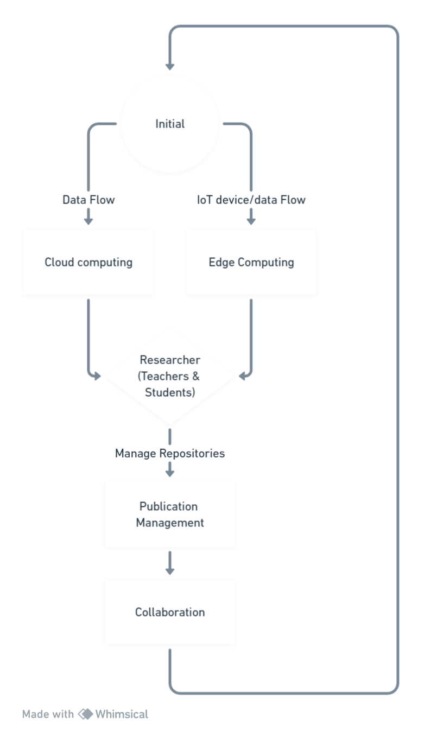
Architecture

Slide 10
Technology Stack
Cloud Technologies (AWS)
Edge Computing Frameworks (AWS IoT Greengrass)
Database Management Systems ( MySQL/PostgreSQL)
Web Development Frameworks (Django, Flask)
Version Control Systems (Git)
Containerization Technologies (Docker/Kubernetes)
Frontend Technologies (HTML, CSS, JavaScript, Node, React.js)
Programming Languages (Python, JavaScript)

Slide 11
Expected System Outcomes
Enhanced accessibility and collaboration among researchers through streamlined method management.
Improved efficiency in developing edge computing solutions.
Seamless integration of cloud and edge technologies for flexible access to methods.
Accelerated research and development process for edge computing applications.
Optimal utilization of resources through automated method attribute measurement and retrieval.
Increased scalability and adaptability to evolving edge computing requirements.

Slide 12
Timeline Chart - Proposed(Tentative)
February: Planning requirements and gathering required softwares for cloud deployment.
March 5: Design completion and development of cloud-based method management module.
March 10: Conduct testing and optimization of the cloud deployment.
March 15: Start exploration of edge computing frameworks for deployment.
March 20: Develop and deploy edge components for local access to the method repository.
March 25: Testing and evaluation performance of edge-enabled method management.
March 30: Conduction of comparative analysis of cloud and edge deployments.
March 31: Compiling findings and preparing the final report for stakeholders.

Slide 13
References
[1] T. Hao, J. Zhan, K. Hwang, W. Gao and X. Wen, "AI-oriented Workload Allocation for Cloud-Edge Computing," 2021 IEEE/ACM 21st International Symposium on Cluster, Cloud and Internet Computing (CCGrid), Melbourne, Australia, 2021, pp. 555-564, doi: 10.1109/CCGrid51090.2021.00065. keywords: {Performance evaluation;Cloud computing;Collaboration;Clustering algorithms;Computer architecture;Benchmark testing;Resource management;edge-cloud computing;edge AI;workload allocation;end-to-end response time}
[2] I. García-Magariño, M. M. Nasralla and J. Lloret, "A Repository of Method Fragments for Agent-Oriented Development of Learning-Based Edge Computing Systems," in IEEE Network, vol. 35, no. 1, pp. 156-162, January/February 2021, doi: 10.1109/MNET.011.2000296.
keywords: {Support vector machines;Measurement;Neural networks;Real-time systems;Edge computing;Multi-agent systems;Software engineering}
[3] Z. Liu et al., "Bridging Data Center AI Systems with Edge Computing for Actionable Information Retrieval," 2021 3rd Annual Workshop on Extreme-scale Experiment-in-the-Loop Computing (XLOOP), St. Louis, MO, USA, 2021, pp. 15-23, doi: 10.1109/XLOOP54565.2021.00008. keywords: {Training;Data centers;Synchrotrons;X-ray lasers;Machine learning;Laser modes;Data models},

Slide 14
Thank You!

